Slide 1
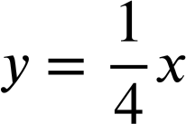
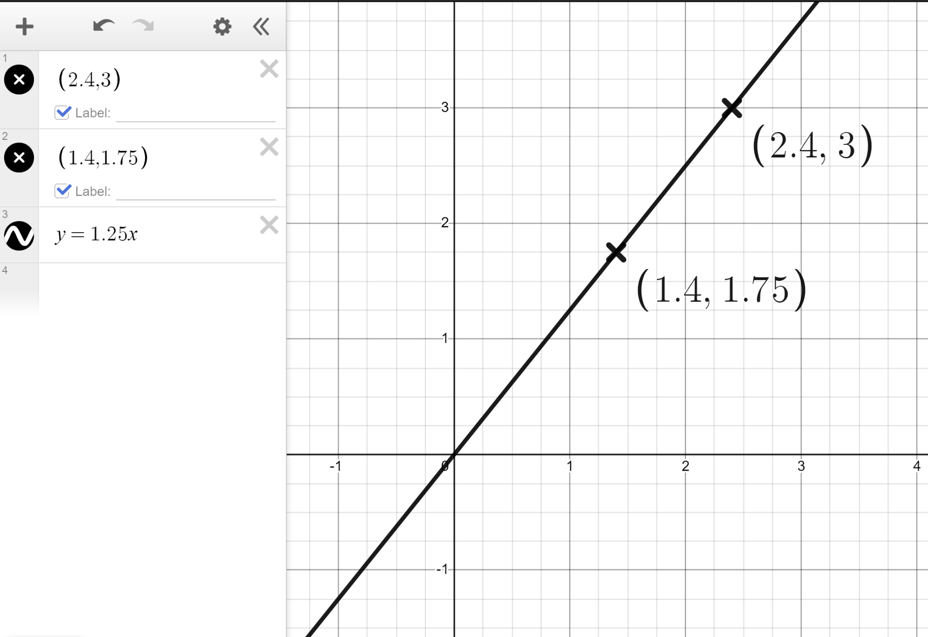
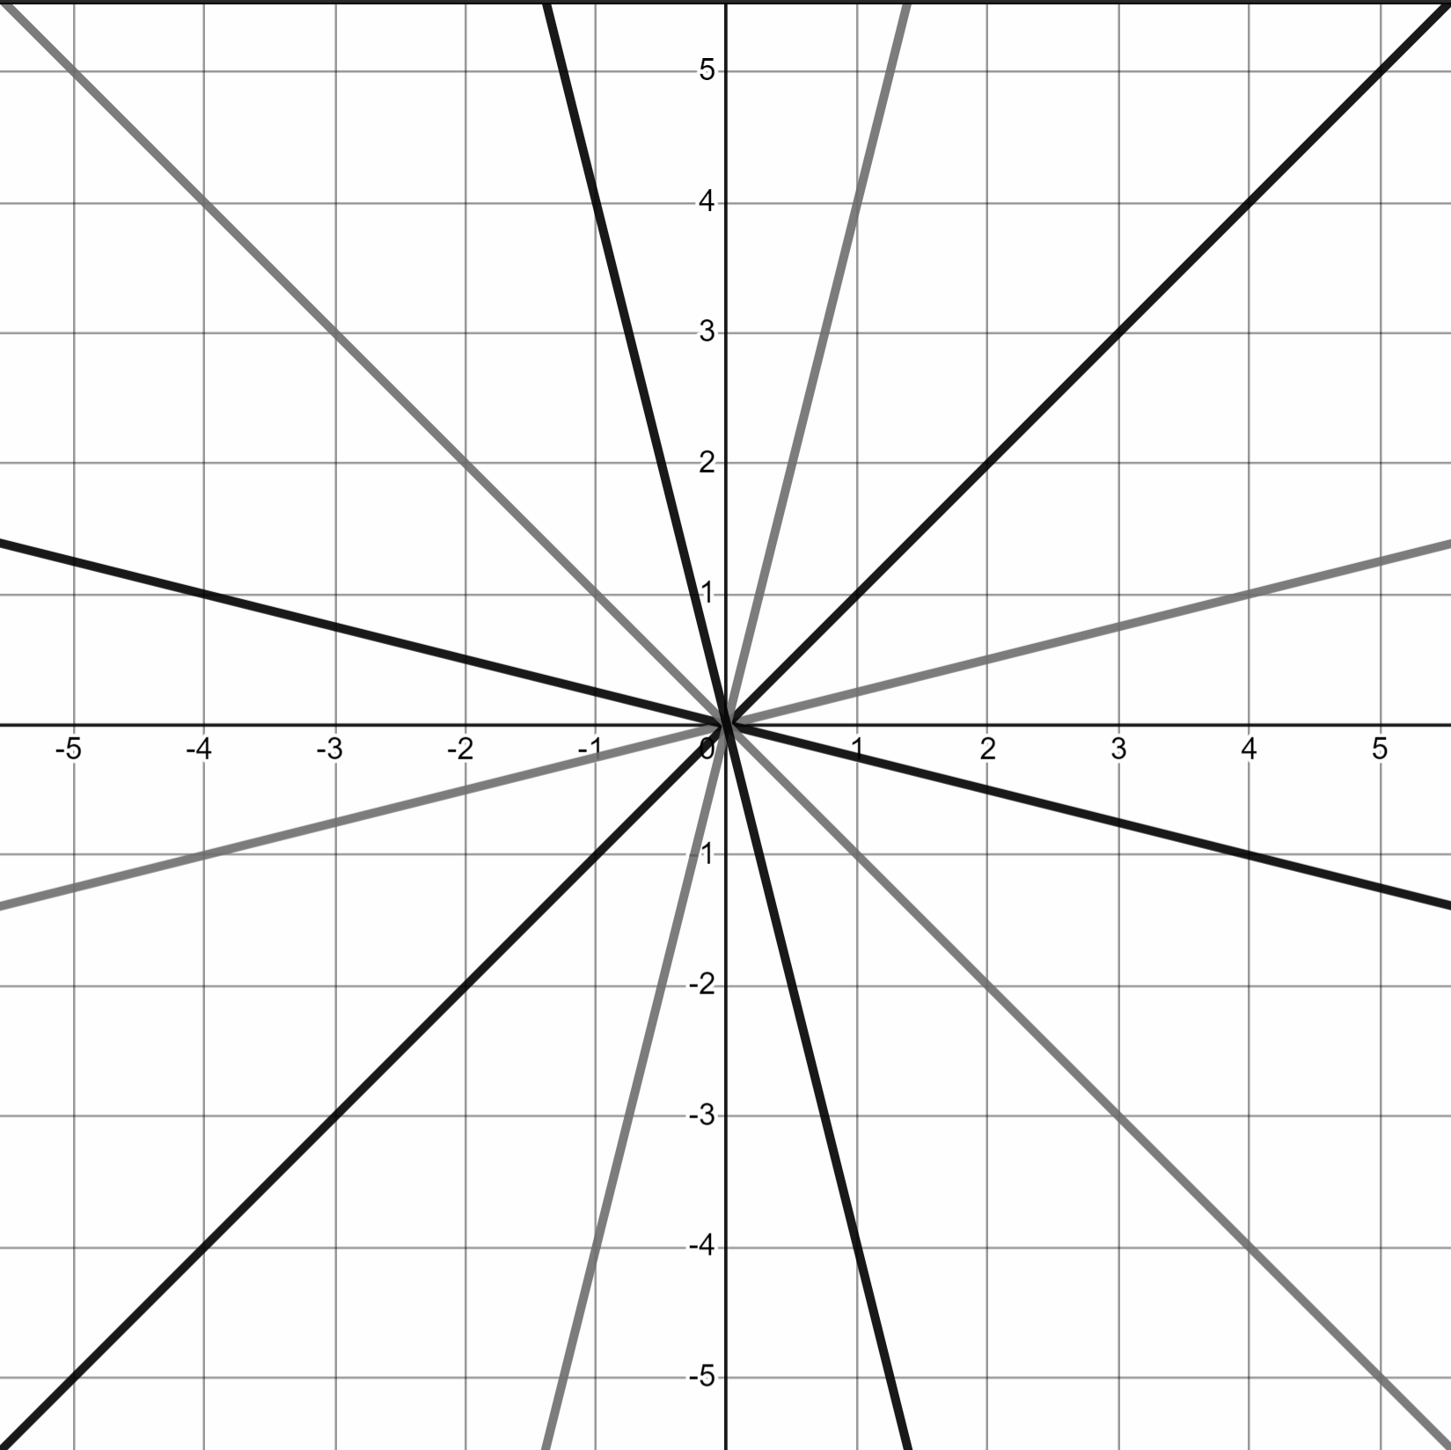
Using dynamic software to explore linear relationships
Task A: Changing the gradient
Dynamic software should be used to complete this task.
1) You are the teacher.
Plot the line y = 3x, add a table, turn the coordinates into crosses, and explain to the Oak students the link between the algebra, the table and the graph.
2) Plot the lines y = −4x and
Compare the two lines.
3) Plot the coordinates (2.4, 3) and (1.4, 1.75) and draw the straight line that goes through both and the origin. What is this line?
4) Draw the lines that recreate this pattern.

Slide 2
Using dynamic software to explore linear relationships
Task B: Changing the y-intercept
Dynamic software should be used to complete this task.
1) Plot the lines and write a sentence or two comparing them.
y = 2x
y = 2x + 3
y = 2x − 4
2) Plot the lines and complete the table.
Line | Gradient | y-intercept
y = 3x + 7 |  | (0, 7)
y = 3x − 2
y = 0.2x + 2
 | 7 | (0, −3)
 | −3 | (0, 7)

Slide 3
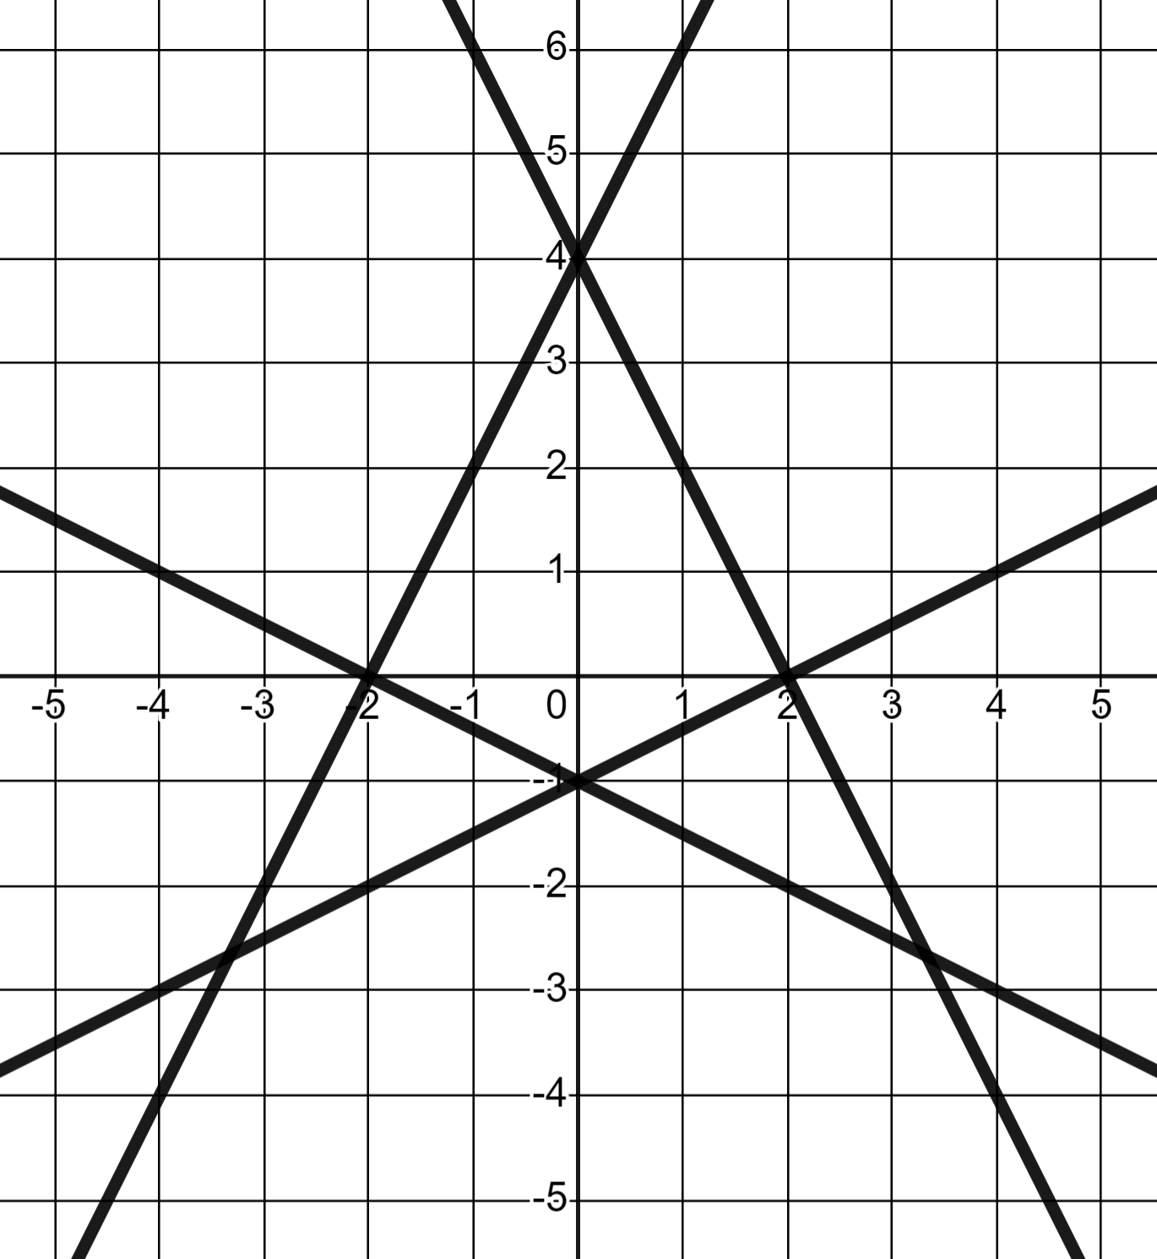
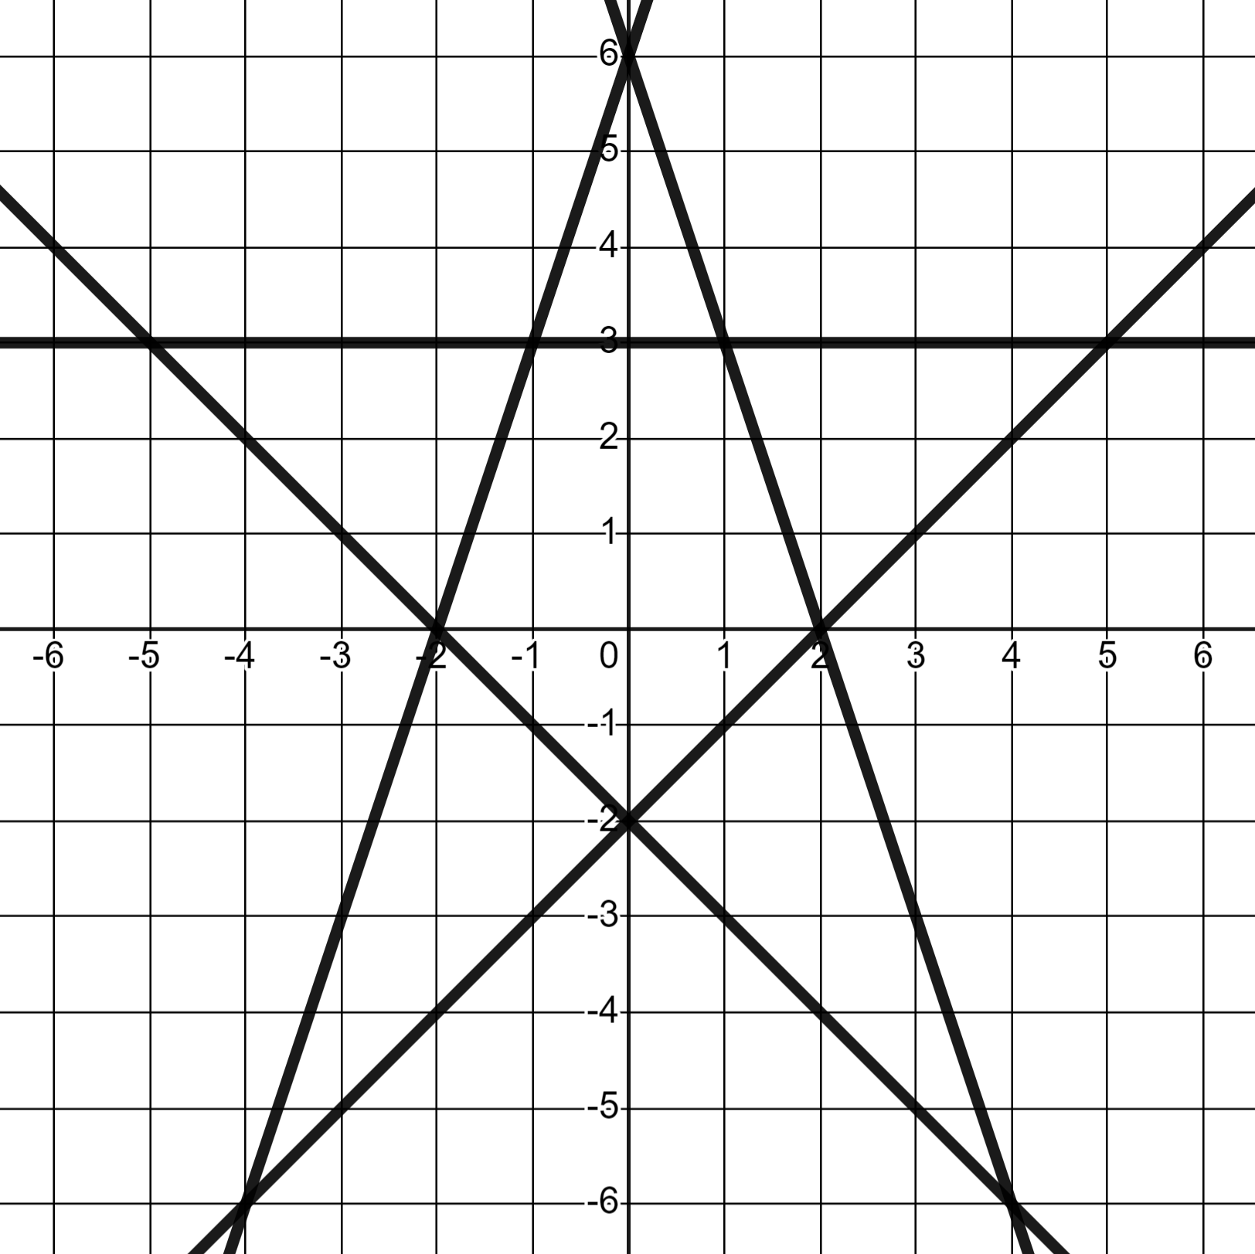
Using dynamic software to explore linear relationships
3) Draw the lines that recreate these patterns.
a)
b)
Mathematics in Education and Industry
v2.2

